Slide 1
Drone Phenology Monitoring
Gaurav Rajput
Parth Thakur

Slide 2
Overview
Recent progress
New Orthomosaic
Detectree2
Problems
HPC

Slide 3
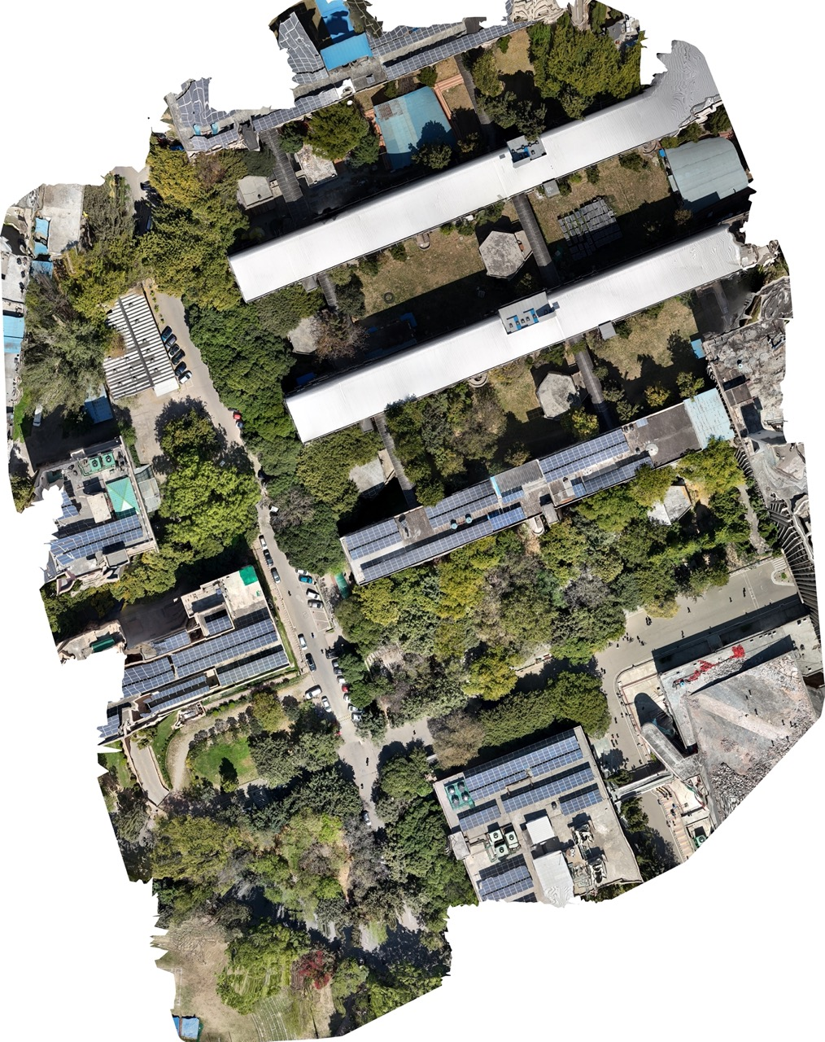
New Orthomosaic
6 Mar 2025

Slide 4
Detectree2
The large orthomosaic was split into 45x45 pixel tiles with a 20-pixel buffer.
This ensures smaller sections are analyzed for better detection accuracy.
Pre trained model 230103_randresize_full.pth
Detectree2 provides a predict_on_data function
Converted tile-based predictions into geo-referenced outputs (GeoJSON)
Filtered overlapping crowns by selecting the most confident detections.
Saved the processed tree crowns as a GeoPackage file (.gpkg).

Slide 5
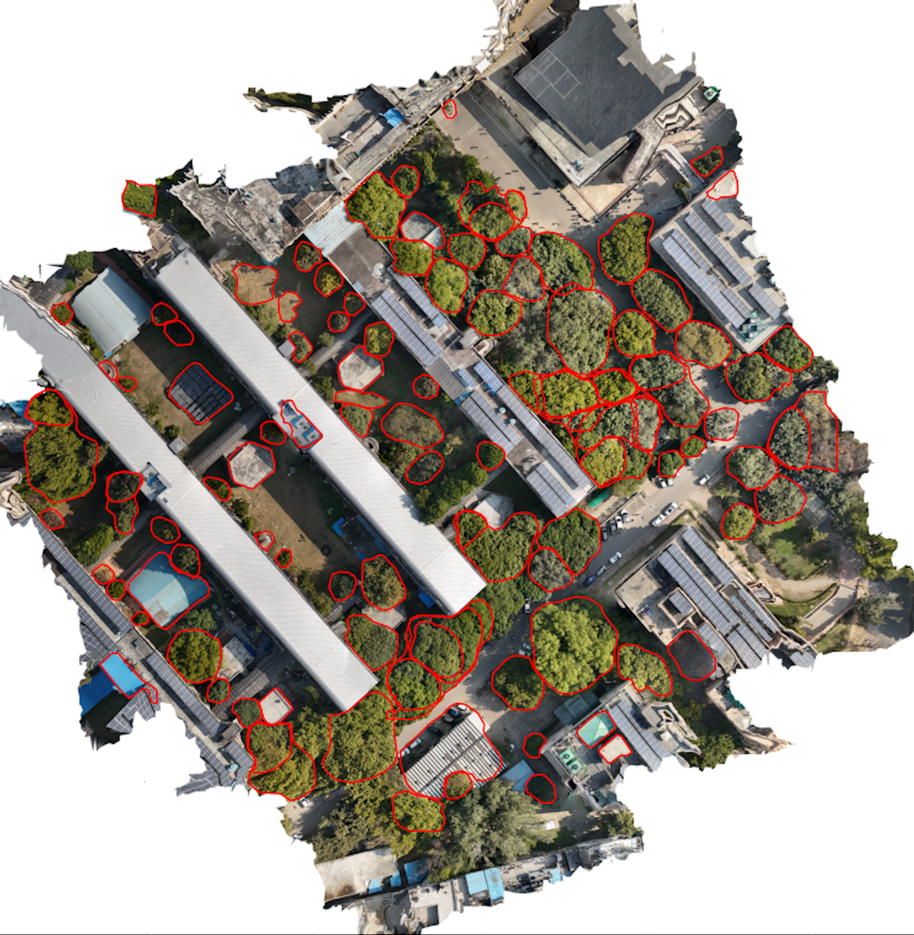
Detectree2
Most tree crowns are accurately detected
Overlapping detections cleaned using IoU filtering (0.4 threshold)
Further fine-tuning may improve results, especially for dense canopies, we are experimenting more with tile size, buffer settings, and finetuning the parameters

Slide 6
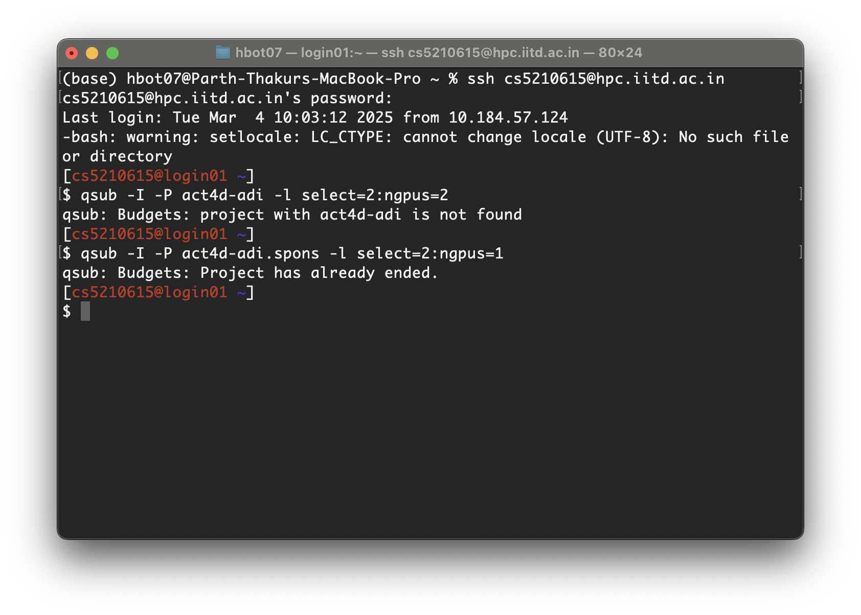
HPC
Took help from Badrinath sir for setting up the HPC, it seems that the project budget has ended
Is any other project/budget available?
Else we can proceed with the GPU workstation we have; can we run a password protected jupyter server on it which we can access remotely?

Slide 7
Next Steps
Integrate detectree2 into our data structure
Build and validate tracking algorithms across the two orthomosaics we have now
Optimize Detectree2 parameters

